Slide 1
SC1015 mini project
Group 3:
Lim Yan Rui
Lua Ker Quan Kevin
Lu Zihao

Slide 2
Table of contents
Problem definition and motivation
Getting Dataset
Format data
Visualising data
Core analysis and Evaluation
Conclusions

Slide 3
Problem definition and Motivation
Background context and problem statement
Technological advancements
Streaming services like Twitch readily available
Covid has induced lockdowns
People unemployed
Streamers gains popularity
Those looking for an alternative stream of income want to know what is popular
Finding the key to popularity on twitch for those looking for a side income.
MOTIVATION
Encourage new streamers to enter the industry
Helping new streamers to gain popularity
Find out possible factors leading to popularity
Increased sponsorships/ advertisements

Slide 4
Strategy
Make use of Twitch API to scrape available data from Twitch
Draw data related to game played, time of stream , language used and hours spent streaming
Make use of a classification model for game, time and language
Linear regression for hours spent
Attempt to find out any relationship between factors and viewer count
Make use of viewer count as a gauge for popularity

Slide 5
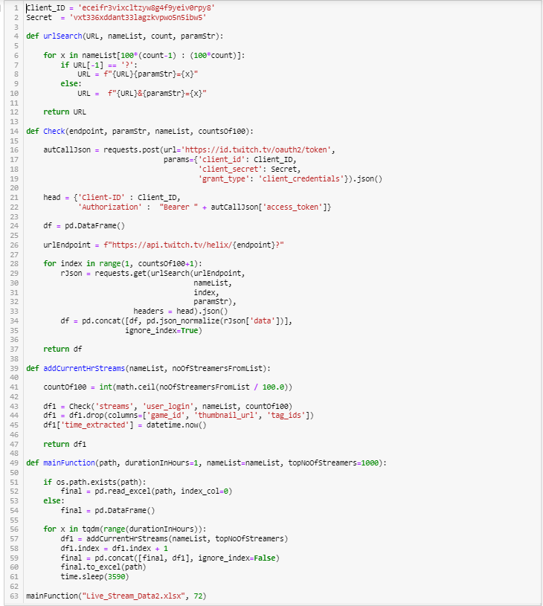
Getting Dataset
Using the twitch api, i extract data to csv file
Data includes
Time
Game
Followers
Language
Concurrent Viewer count
From top 1000 streamers, data extracted over a 2-week time frame

Slide 6
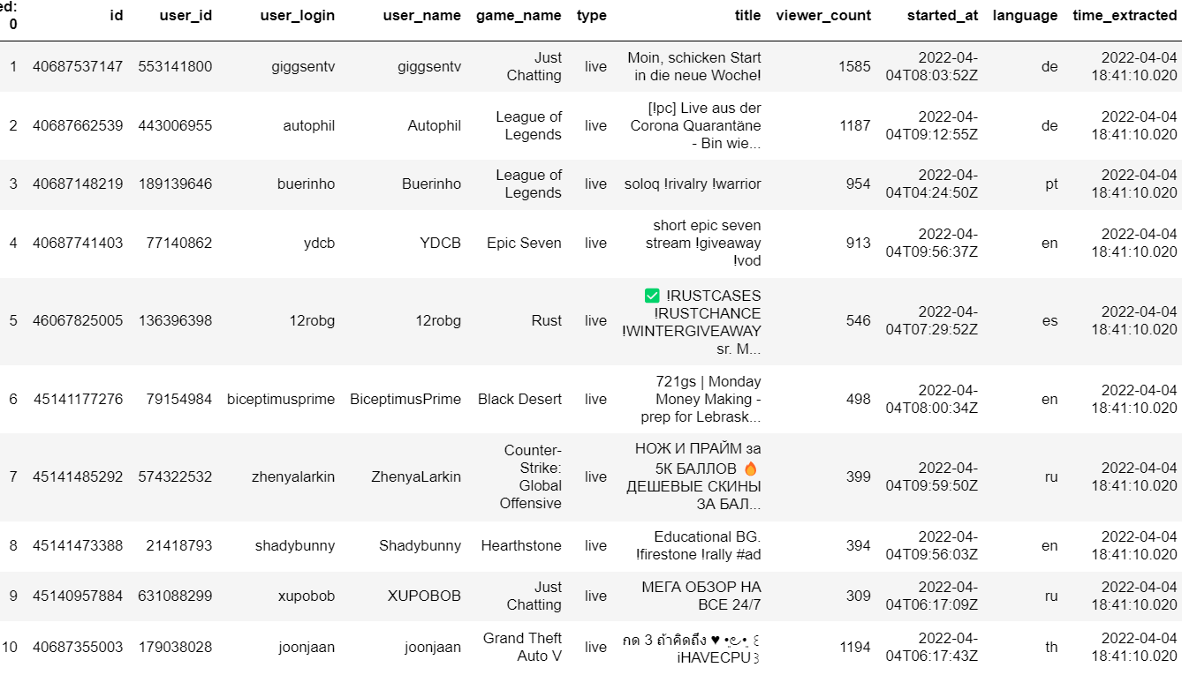
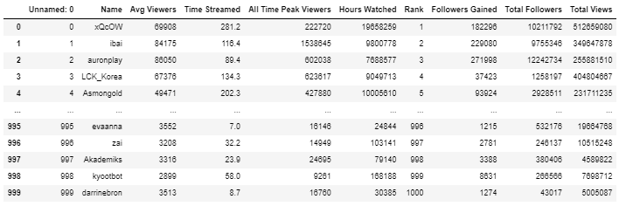
Datasets
Extraction of live streams for 2 weeks and general information of top 1000 streamers.

Slide 7
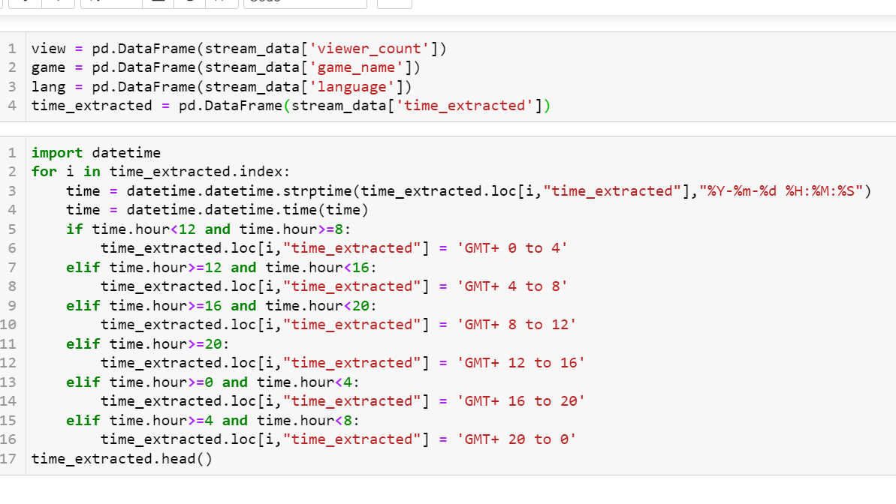
Formatting data

Slide 8
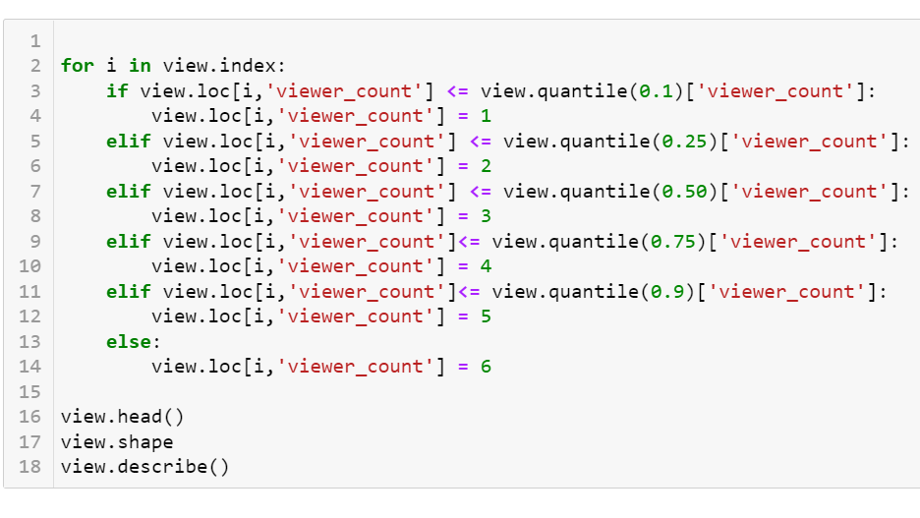
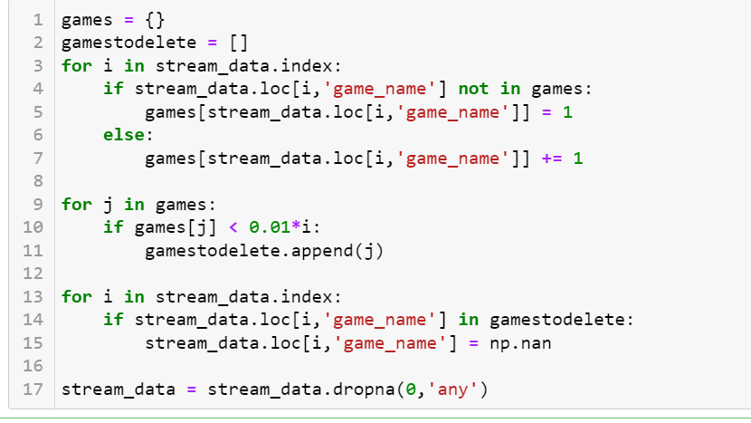
Formatting data

Slide 9
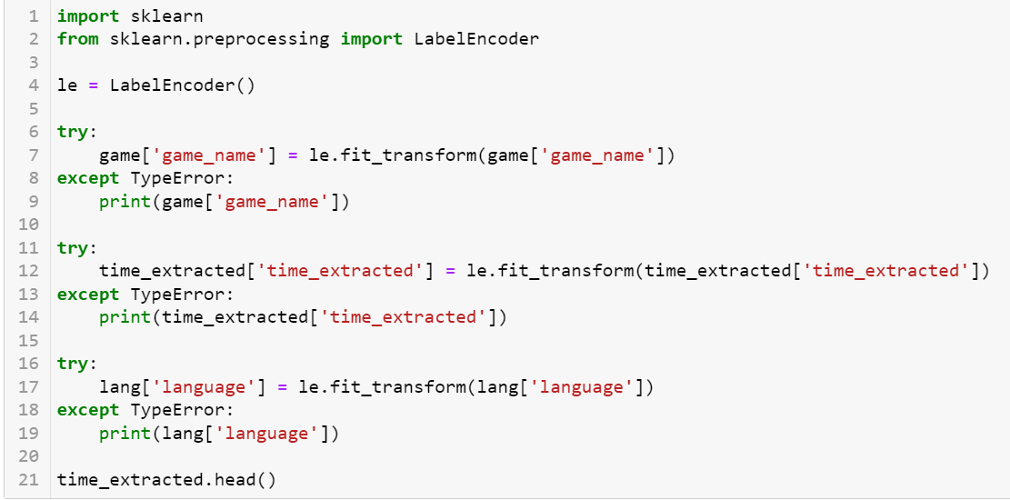
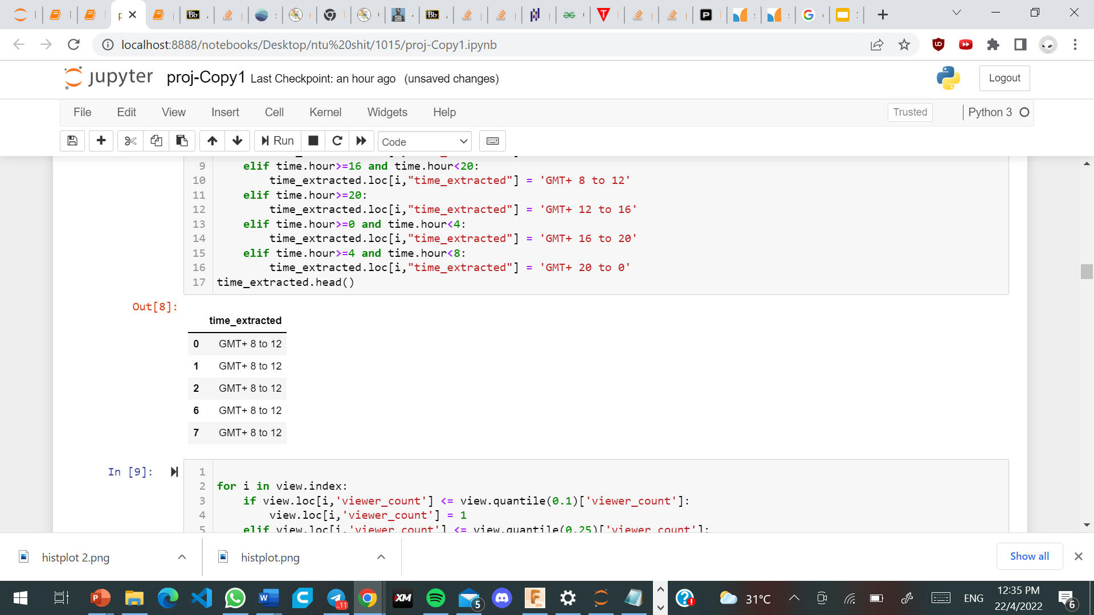
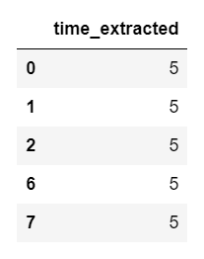
Formatting data

Slide 10
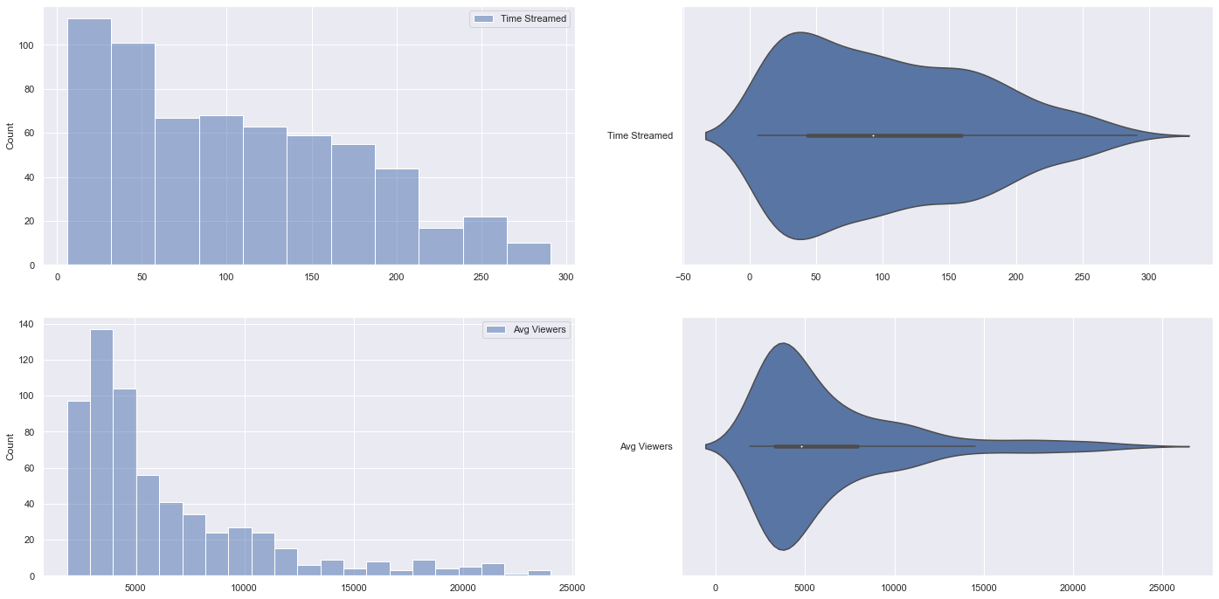
Visualising data

Slide 11
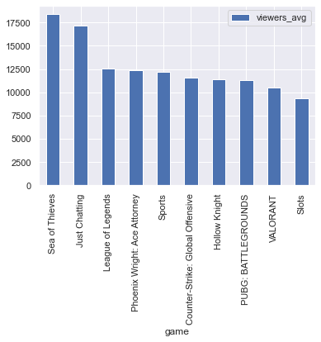
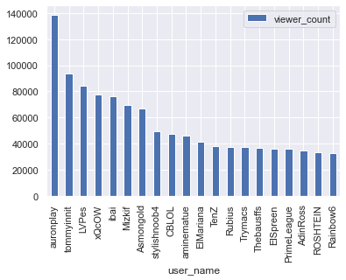
Visualising data

Slide 12
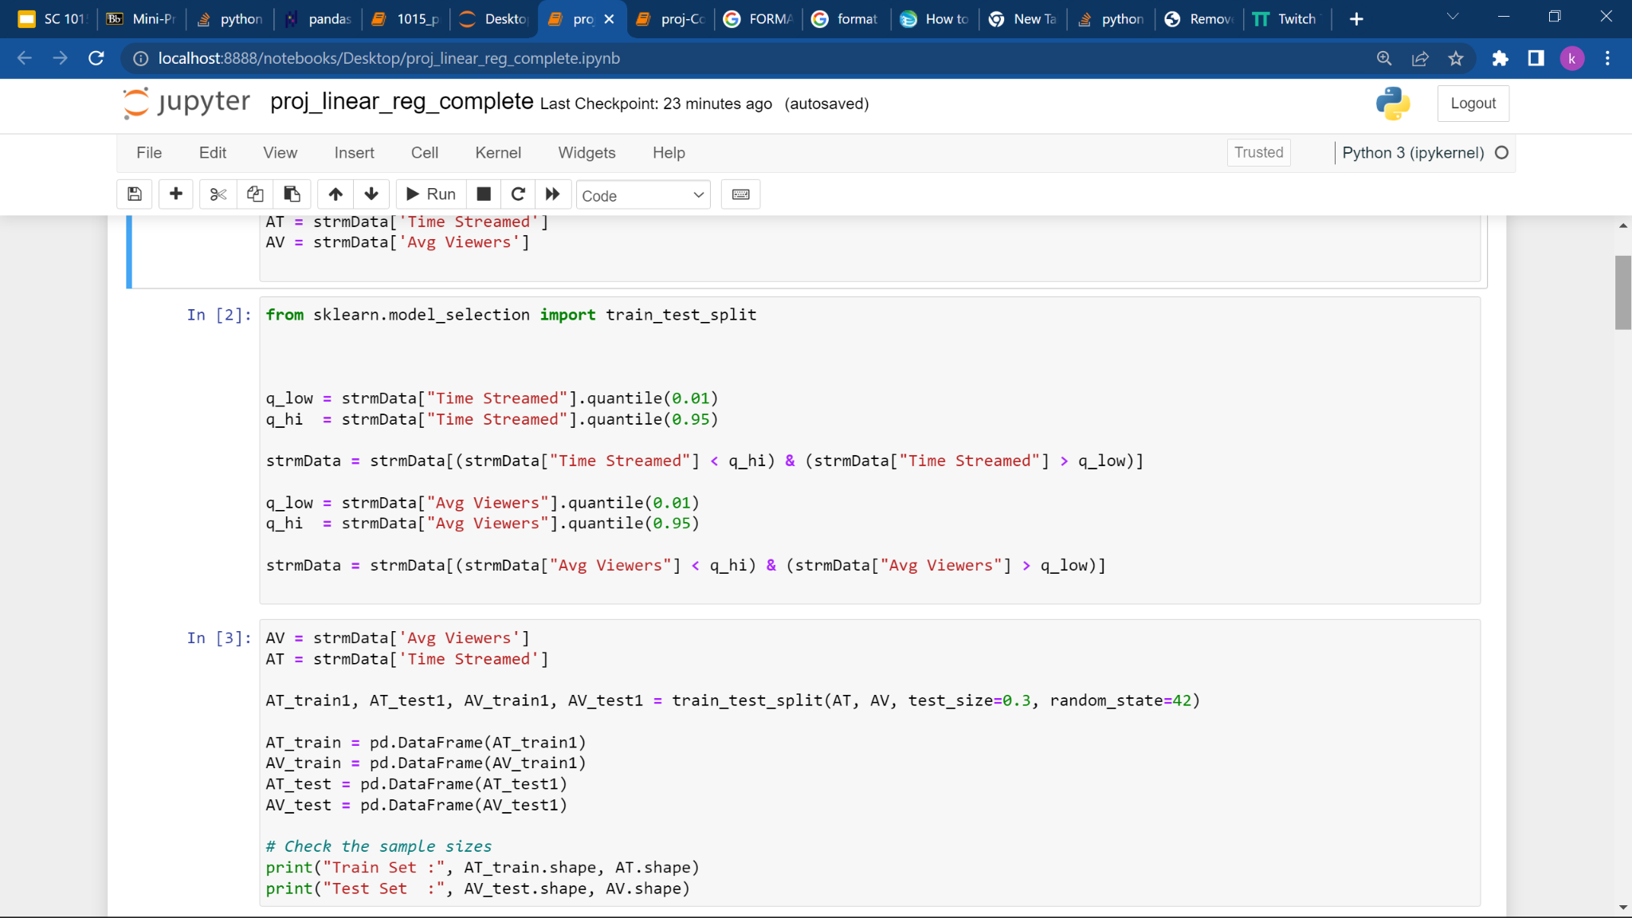
Core analysis and Evaluation
Explore the proposed relationship between average hours of stream and average viewer count using linear regression model
Clearing outliers that affect the accuracy of our model
Splitting the data into train and test groups for machine learning
Notes:
Outlier removal

Slide 13
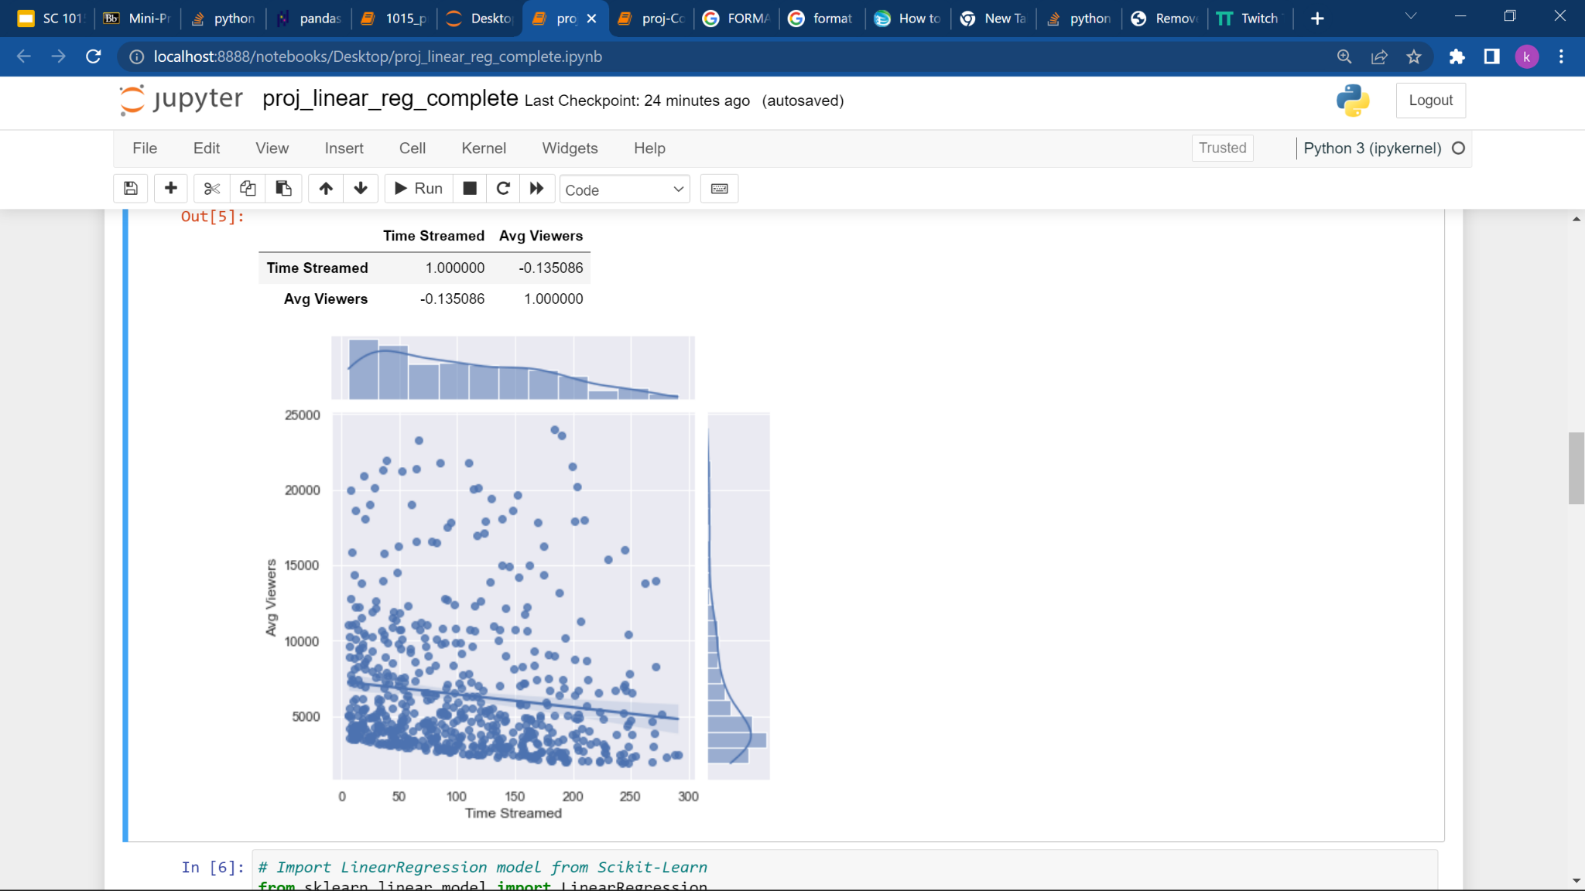
Core analysis and Evaluation
Correlation coefficient
Negative value close to zero
Indicating low likelihood of linear relationship between average number of stream hours and average viewers

Slide 14
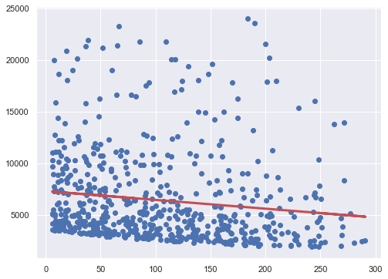
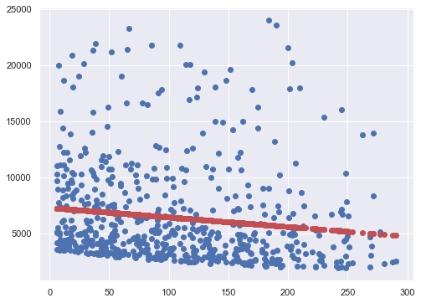
Core analysis and Evaluation
Plotting the regression line (left)
Calculate predicted values for average viewer count using average stream hours from train group

Slide 15
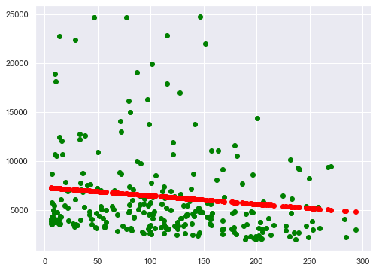
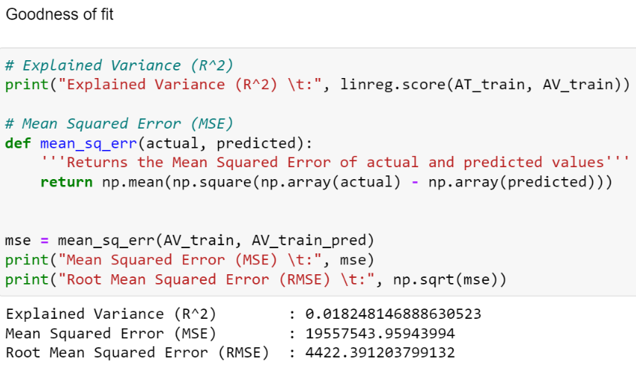
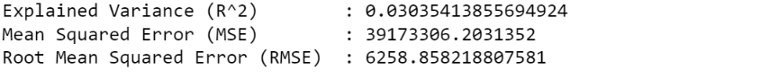
Core analysis and Evaluation
Predicted results for average viewer count based on average stream hours based on the test group
Poor explained variance and large MSE indicates that linear regression model fails to fit
As such, more efforts on longer hours of stream does not necessarily mean a linear reward of more viewership. There may be more dominant factors affecting popularity of stream

Slide 16
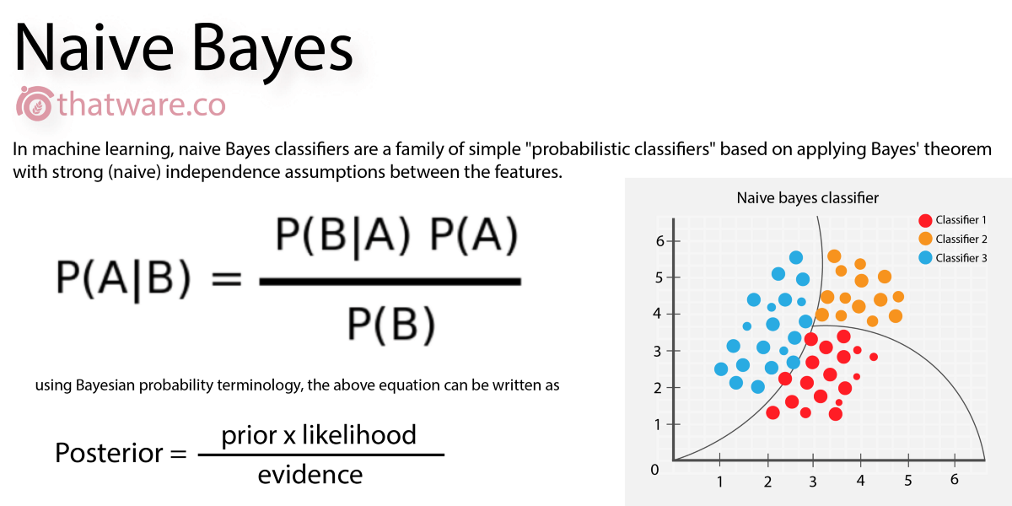
Core analysis and Evaluation
Naive Bayes Classifier
Rely on Bayes's theorem
Describes the relationship of conditional probabilities of statistical quantities.
Interested in finding the probability of a label given some observed features.
Assumes that features are independent

Slide 17

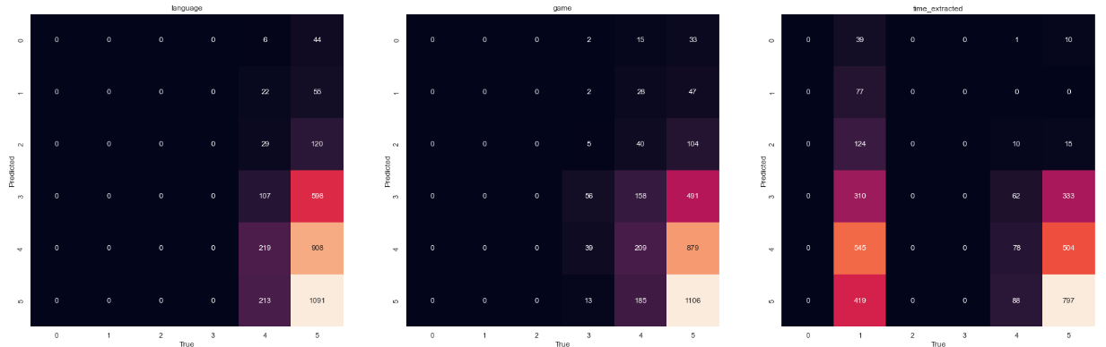
Core Analysis and Evaluation
Low Accuracy scores
Low relation between features and viewer count

Slide 18
Core Analysis and Evaluation
From a cursory glance top games have much more average viewers than other games
Inability of the model to guarantee a decent view count based on game played
Partly due to large variety of content even for the same game
Popularity boils down to content and personality of streamer

